Slide 1

Welcome to Lura school
Parent meeting new 1. year 20.05.2026

Slide 2
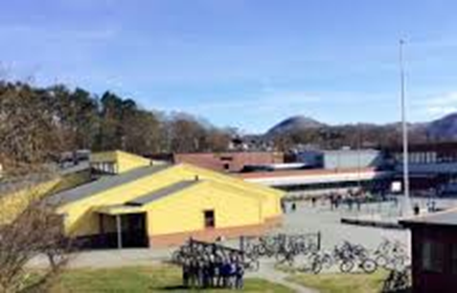
About Lura school
Approximately 300 students
50 staff (teachers and assistants)
About 50 % of the students have multicultural background, or not Norwegian background
Between 20-30 different languages spoken
Introduction class for students new in Norway needing to learn Norwegian (45 spots)

Slide 3

The school’s administration
School secretary: Torunn Joensen
3 deputès:
  ASC – Carl Gunnar Eide
  1.-3. trinn + IC - Elin Røkeberg Lid
  4.-7. trinn - Laila Lønning
Principal: Lone Lunde

Slide 4

Presentation
Year 1
Staff year 1:
  Ruth Helene Ramstad
  Lisbeth Meland
  Karen Berg Tangen
  Gro Carlsen Holmen
  Ane Nylund
37 students, in two groups
3 teachers
2 staff in each room

Slide 5
What’s our focus?
We emphasize inclusive practices aimed at enabling academic and personal achievement for all learners
Early literacy instruction emphasizing accelerated letter acquisition
Play-based learning.
A positive and safe transition into school - buddy
Shared experiences
Outdoor school – practical learning

Slide 6

Together we leave valuable marks
Why is it important that the school and you, the parents, collaborate?
Parents contribute to building safe and positive learning environments for students through:
  Collaboration with other parents
  Collaboration with the teachers
  Contributing as class representatives
    Election of class representatives
  Participation in the Parents’ Working Committee (FAU)
    Election of FAU representative and deputy representative

Slide 7

How can parents contribute to building safe and positive learning environment?
Speak positively about the school
Speak positively about other students
Be mindful that all students should feel well an included
Participate in joint activities
Ensure inclusive practices, such as inviting all students in the group to social events (e.g., birthdays)

Slide 8
Safe and positive learning environment
Edu. act chpt 12
All students have the right to a safe and positive learning environment that promotes health, well-being, learning, and inclusion.
The school shall therefore work preventively, to the greatest extent possible, to prevent bullying and exclusion.
The school’s duty to act
If you are concerned: Report it to the school (class teacher or school leadership).

Slide 9
Social competence prevents bullying
Characteristics:
Ability to understand and take the perspective of others
Awareness of what it feels like to be excluded
Awareness of what it feels like to lack friendships
Students with well-developed social and emotional competence engage less in bullying and possess a broader repertoire of strategies for interacting with others.
Social competence develops over time through interaction, both at home and at school.

Slide 10

Important social skills to practise:
Waiting for one’s turn
Listening to others
Being able to share
Being able to lose in games
Being able to win in games
Interacting appropriately with both boys and girls
Using the toilet independently
Dressing oneself independently

Slide 11

Reading – Parents play a crucial role in their child’s literacy development
50 000 ord - Visste du at du kan forandre et barns liv? on Vimeo
Dette bildet av Ukjent forfatter er lisensiert under CC BY-NC

Slide 12
Class assignment
Classes are not formed until Year 2.
Factors that MAY be considered when forming groups:
Other children from the same area (having someone to walk to school with)
A balanced mix of boys and girls
What we do not prioritize:
Which children attended the same kindergarten (preschool), because:
  Experience shows that children form new friendships across groups when they start school
  It is beneficial to break up existing constellations and patterns

Slide 13
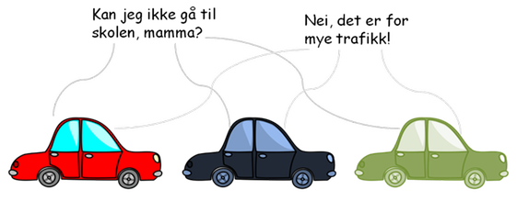
Traffic around school
Practice walking to school!
The school route becomes unsafe if everyone drives their child to school.
Temporary drop-off zone in Eikeveien (Normally by Lura Church).

Slide 14

Clarifying expectations:
Our expectations of you:
Parents/guardians have the primary responsibility for their child’s upbringing and learning
The child arrives at school on time, i.e. ready before the bell rings at 08:15
The child has eaten breakfast and brings a packed lunch
The child has had sufficient sleep
The child brings the necessary and appropriate equipment

Slide 15
Clarifying expectations:
Parents/guardians respond to messages from the school
Parents/guardians attend parent–teacher conferences and parent meetings at the school
Parents/guardians speak positively about the school and fellow students at home
Parents/guardians maintain a low threshold for contacting the school, both to provide information about their child and to seek information
Parental support is expected
Dette bildet av Ukjent forfatter er lisensiert under CC BY

Slide 16
What should you expect from us?
The school supports parents/guardians in their child’s learning and upbringing
The school is responsible for the academic provision
The school has teachers who are caring and committed to the well-being of your child
The school contributes to the development of social skills
The school facilitates effective cooperation with the home
Introductory meeting in September (when there is a new class teacher)
Dette bildet av Ukjent forfatter er lisensiert under CC BY

Slide 17
What should you expect from us?
The school documents and informs parents/guardians about the student’s progress.
Parent–teacher conferences are held twice a year.
Teachers are clear and supportive classroom leaders, maintaining good order and structure.
The school speaks positively about the home. Conflicts are addressed at the adult level (without the child present).
The home is taken seriously.
The school takes all concerns regarding the student seriously.
Dette bildet av Ukjent forfatter er lisensiert under CC BY

Slide 18

School nurse
Who: Anja Langeland, School nurse
Where : 2. floor, at entrance F
Available: Monday, Tuesday, Wednesday, Friday.
Contact information: mobile 488 66 843 anja.langeland@sandnes.kommune.no
See the schools web-page for more information

Slide 19
Focus:
Health promotion and preventive practices
Low-threshold service, easily accessible to students and parents/guardians
Confidentiality is ensured
Monitoring of growth and development, including vision and hearing
Provision of supportive counselling for students facing social and emotional challenges; an open-door policy is maintained
Guidance and support are provided to parents in their parenting role

Slide 20
What happens in year 1?
Classroom visits to get to know the students
School entry health screening, including a consultation with the school nurse and a medical examination at the health center. You will receive an appointment notice.
Classroom-based instruction on a range of topics

Slide 21
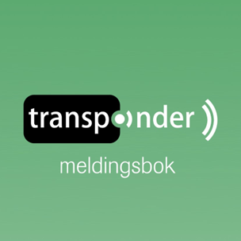
Usefull information:
Communication platform (Meldebok)
Use the Transponder SMS solution/app
Notify the school via SMS in case of illness, before 07:45
You can expect a response between 08:00 and 17:00 on weekdays
School milk programme
Order at skolelyst.no

Slide 22
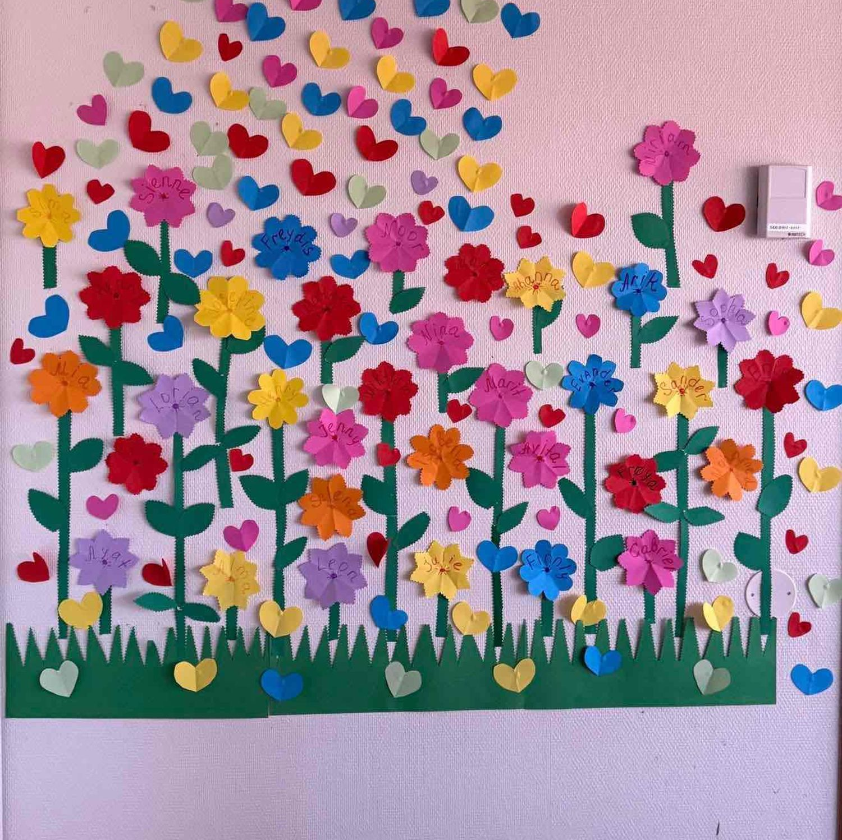

Welcome to Lura ASC 2026
- First day after summer: 04.08.2026.
- Open between 0730 – 1630
- Orientation day 27.05.26, kl. 16:45-17:45
100% spot or 60% spot:
60% = 3 days or 5 days to 3:15pm: free
2 full days during weeks of school holiday
100% = All days, mornings and afternoons + holidays: 1698NOK
Every day during weeks of school holiday
Extra fee for food

Slide 23
August:
A calm and gradual transition period
Play and activities designed to help children feel safe and become familiar with other children and adults
Year 1 students are given ample time and space of their own
You may decide yourselves how long your child stays in the AFC in the beginning.
Packed lunch/drink bottle – during the initial period Spare clothes
Rainwear/boots

Slide 24
- Plenty of time to play
- Culture
- The enjoyment of physical activity
- Promotion of positive meal experience
Activities in the ASC
Framework Plan for School-Age Childcare (SFO) and regulations for Sandnes Municipality

Slide 25
Transponder:
Messages, pick-up and drop-off –
fixed or daily arrangements
Please register information before 12:00 each day (preferably)
Keep it simple – avoid giving too many options
If the child is to leave at 15:30, then the child leaves at 15:30
Please contact the us if you have any questions or other inquiries
Check the school’s website for monthly plans and similar information

Slide 26

Smartmobile-free childhood
The parent councils (FAU) at Lura and Porsholen collaborate with the schools on this initiative.
Smartphones and social media are the source of many conflicts that spill over into the school day.
Allowing children to use social media can pose a safety risk for the child.
It is desirable for the parent group to collectively “commit” to not giving children a smartphone before lower secondary school age.
Dette bildet av Ukjent forfatter er lisensiert under CC BY

Slide 27

Boka om meg
Every student has received a copy of “Boka om meg” (The book about me).
Please complete it over the summer.
Bring it back to school on the first day of term.
We look forward to seeing you again on August 13th at 9:00 AM!
Tips: Football for girls and boys age 5-6 at Porsholen school every Monday at 5pm.
COME AND JOIN!

